Slide 1
Eleven Wise Monkeys Final Project – Soccer Simulator
Software Engineering CSCI 306 Fall 2013

Slide 2
Our Team
Danny Victor
Leah Moldauer
Paulo Iza

Slide 3
Design
Goals:
Create a simulator to run through a single soccer play
Implement random movement player behavior
Program an intuitive GUI

Slide 4
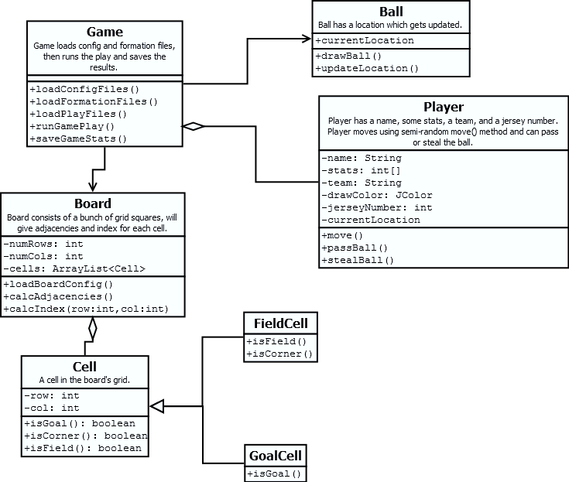
UML

Slide 5
Lessons Learned
Group work can be difficult, especially over the holidays
Timers are hard. Very hard.
Bottom up design is better than regressive design
GitHub is really useful, but merging is painful
Changing the board size and adding players cause massive headaches when rewriting test cases

